Slide 1



FINAL PROJECT – Intermediate Python Batch 4
Ariadi Hendrawan

Slide 2


Merupakan layanan yang dapat membantu Anda untuk menyewa tempat menginap ataupun menyewakan rumah anda untuk orang lain.
Didirikan pada 2007 oleh Brian Chesky & Joe Gebbia di SF.
Berawal dari ketidakmampuan mereka untuk membayar sewa apartemen mereka. Akhirnya mereka menyulap sebagian ruang apartemen mereka menjadi tempat menginap.
NOW : 2,9m hosts, 100k cities, 220 countries, 14k emply

Slide 3

The data tells about….
Data tersebut menunjukkan daftar rumah-rumah yang menjadi partner Airbnb, dan disewakan kepada para customer. Juga diberikan data berupa lokasi, harga sewa, jumlah hari minimum, jumlah review, dan availabilitynya. Dari data-data tersebut kita bisa menganalisa distribusi harga sewa di antara berbagai jenis rumah dan di lokasi-lokasi yang berbeda, dan memperkirakan faktor-faktor apa saja yang mempengaruhi tingkat hunian suatu jenis rumah. Dengan mengetahui insight dari data tersebut, bisa diketahui segment bisnis mana yang lebih menjanjikan bagi para investor.

Slide 4
Properties of data
<class 'pandas.core.frame.DataFrame'>
RangeIndex: 48895 entries, 0 to 48894
Data columns (total 16 columns):
# Column Non-Null Count Dtype
--- ------ -------------- -----
0 id 48895 non-null int64
1 name 48879 non-null object
2 host_id 48895 non-null int64
3 host_name 48874 non-null object
4 neighbourhood_group 48895 non-null object
5 neighbourhood 48895 non-null object
6 latitude 48895 non-null float64
7 longitude 48895 non-null float64
8 room_type 48895 non-null object
9 price 48895 non-null int64
10 minimum_nights 48895 non-null int64
11 number_of_reviews 48895 non-null int64
12 last_review 38843 non-null object
13 reviews_per_month 38843 non-null float64
14 calculated_host_listings_count 48895 non-null int64
15 availability_365 48895 non-null int64

Slide 5
Data Description
 | Price | Min nights | Nmbr Rev | Rev per Mo | Host List | Availability
count | 48.895 | 48.895 | 48.895 | 48.895 | 48.895 | 48.895
mean | 152,721 | 7,030 | 23,274 | 1.373.221 | 7.143.982 | 112,781
std | 240,154 | 20,511 | 44,551 | 1.680.442 | 32.952.519 | 131,622
min | 0 | 1 | 0 | 0 | 1 | 0
25% | 69 | 1 | 1 | 0,190 | 1 | 0
50% | 106 | 3 | 5 | 0,720 | 1 | 45
75% | 175 | 5 | 24 | 2,020 | 2 | 227
max | 10.000 | 1.250 | 629 | 58,500 | 327 | 365

Slide 6
data.isna().sum()
id 0
name 16
host_id 0
host_name 21
neighbourhood_group 0
neighbourhood 0
latitude 0
longitude 0
room_type 0
price 0
minimum_nights 0
number_of_reviews 0
last_review 10052
reviews_per_month 10052
calculated_host_listings_count 0
availability_365 0

Slide 7
Ged rid of the missing value
new_data1=data.drop(axis=1,columns=["name","host_name"])
new_data1["last_review"] = new_data1["last_review"].fillna( new_data1["last_review"].mode()[0] )
new_data1["reviews_per_month"] = new_data1["reviews_per_month"].fillna( new_data1["reviews_per_month"].mean())

Slide 8
new_data1.isna().sum()
id 0
host_id 0
neighbourhood_group 0
neighbourhood 0
latitude 0
longitude 0
room_type 0
price 0
minimum_nights 0
number_of_reviews 0
last_review 0
reviews_per_month 0
calculated_host_listings_count 0
availability_365 0

Slide 9
Categories based on Price
Cheap < = 69 Q1
Medium between 69 & 175
Expensive >= 175 Q3
conditions = [ new_data1['price'] >= 175, (new_data1['price'] < 175) & (new_data1['price']> 69), new_data1['price'] <= 69 ]
choices = [ "Expensive", "Medium", "Cheap" ]
new_data1["CATEGORY"] = np.select(conditions, choices)

Slide 10
id host_id neighbourhood_group room_type price CATEGORY
0 2539 2787 Brooklyn Private room 149 Medium
1 2595 2845 Manhattan Entire home/apt 225 Expensive
2 3647 4632 Manhattan Private room 150 Medium
3 3831 4869 Brooklyn Entire home/apt 89 Medium
4 5022 7192 Manhattan Entire home/apt 80 Medium

Slide 11
Filter - last rev date > 2019
new_data1["last_review"] = pd.to_datetime(new_data1["last_review"])
new_data2 = new_data1[new_data1["last_review"].dt.strftime('%Y') == '2019']

Slide 12
new_data2.isna().sum()
<class 'pandas.core.frame.DataFrame'>
Int64Index: 35261 entries, 1 to 48894
Data columns (total 15 columns):
# Column Non-Null Count Dtype
--- ------ -------------- -----
0 id 35261 non-null int64
1 host_id 35261 non-null int64
2 neighbourhood_group 35261 non-null object
3 neighbourhood 35261 non-null object
4 latitude 35261 non-null float64
5 longitude 35261 non-null float64
6 room_type 35261 non-null object
7 price 35261 non-null int64
8 minimum_nights 35261 non-null int64
9 number_of_reviews 35261 non-null int64
10 last_review 35261 non-null datetime64[ns]
11 reviews_per_month 35261 non-null float64
12 calculated_host_listings_count 35261 non-null int64
13 availability_365 35261 non-null int64
14 CATEGORY 35261 non-null object
dtypes: datetime64[ns](1), float64(3), int64(7), object(4)
memory usage: 4.3+ MB

Slide 13
Visualize the price
new_data2.groupby("room_type")["price"].describe()
count mean std min 25% 50% 75% max
room_type
Entire home/apt 18343 218.396 275.762 0.0 120.0 169.0 245.0 10000
Private room 16017 90.404 139.312 0.0 51.0 70.0 98.0 7500
Shared room 901 65.763 79.345 0.0 32.0 45.0 75.0 1000

Slide 14
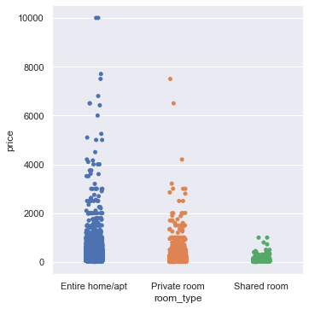
Price comparison based on room type

Slide 15
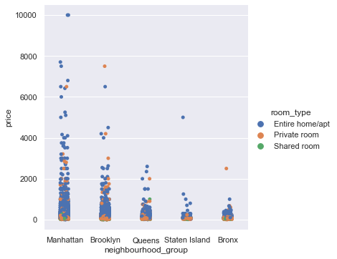
Price comparison based on neighbourhood group & room type

Slide 16
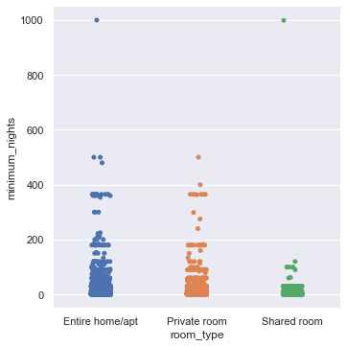
Minimum nights comparison based on room type

Slide 17
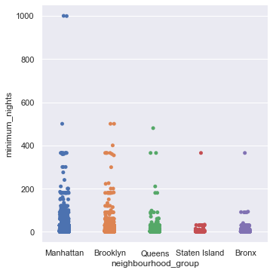
Minimum nights comparison based on neighbourhood group

Slide 18
Conclusion
Beware of the ouliers
Tipe rumah dengan harga sewa paling mahal : Entire home / apartment
Lokasi dengan harga sewa paling mahal : Manhattan
Customer lebih lama menetap di rumah jenis Entire home / apartment dan berlokasi di Manhattan / Brooklyn.
Investasi di Airbnb sangat dipengaruhi oleh jenis rumah & lokasi.

Slide 19

Thank You
ariadi.hendrawan@gmail.com

